Slide 1
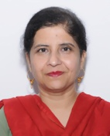
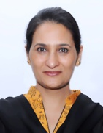
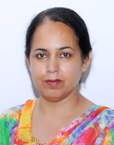
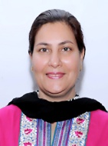
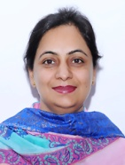
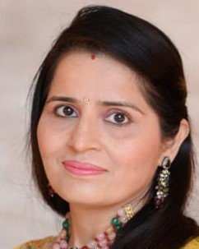
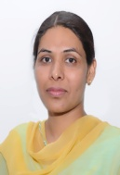
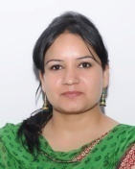
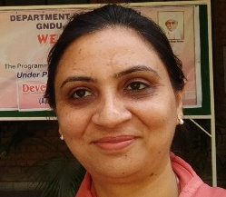
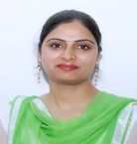
list of full time fAculty members
Name of full time teachers | Designation | Highest Qualification | Experience in the Institution | Total teaching experience
 |  |  | From - To | in years
Dr.Harpreet Kaur | Associate Professor | M.A. ( Eng), M.Ed, M.Phil ( Edu), Ph.D (Edu) | 24.10.1990 to till date | 35 years
Dr Nirmal jit Kaur | Associate Professor | M.A. ( His, Geo), M.Ed, M.Phil ( Edu), Ph.D (Edu) | 16.08.97 to till date | 29 years
Dr. Gurjit Kaur | Associate Professor | M.A. ( Pol. Sci), M.Ed, M.Phil (Edu), Ph.D (Edu) | 01.08.98 to till date | 25 years
Dr.Bindu Sharma | Assistant Professor | M.Sc(Bot), M.A (Psy) M.Ed, UGC NET (Edu), Ph.D (Edu) | 4.09.2000 to till date | 22 years
Dr. Maninder Kaur | Assistant Professor | M.A.(Eco), M.Ed, UGC NET (Edu),Ph.D (Edu) | 13.8.2001 to till date | 22 years
Dr. Deepika Kohli | Assistant Professor | M.Com, M.A. (Soci), M.Ed, UGC /NET(Edu), Ph.D (Edu) | 17.8.2009 to till date | 14 years
Dr. Satinder Dhillon | Assistant Professor | M.Sc (Maths), M.Ed ,UGC NET(Edu), Ph.D (Edu) | 22.04.15 to till date | 15 years
Dr Suman Saggu | Assistant Professor | M.Sc.(Zoo), M.Ed, NET(Edu)Ph.D.(Edu) | 15.7.15 to till date | 14 years
Dr.Manpreet Kaur | Assistant Professor | M.A ( Psy), M.Ed ( Edu), NET(Edu), Ph.D (Psy) | 01.06.2015 to till date | 15 years
Dr.Jyotpreet Kaur | Assistant Professor | M.Sc.(Bot), M.Ed, NET(Edu)Ph.D.(Edu) | 31.10.2015 to till date | 17 years
Mrs. Rajwinder Kaur Sekhon | Assistant Professor | M.Com, MA (Pbi), NET(Edu)M.Ed | 1.06.15 to till date | 15 years

Slide 2
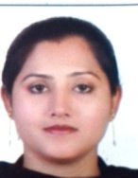
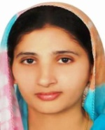
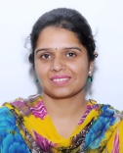
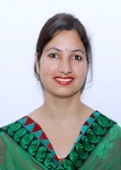
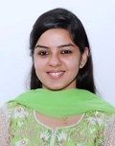
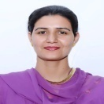
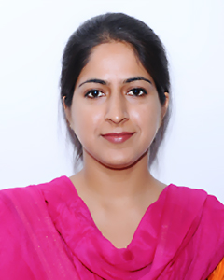
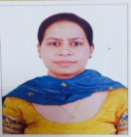
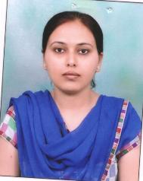
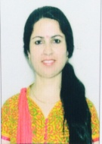
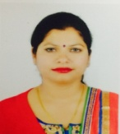
Dr. Baljit Kaur | Assistant Professor | M.Sc.(Maths), M.Ed(Edu), UGC NET (Edu),Ph.D.(Edu) | 28.3.2018 to till date | 15 years
Dr. Avneet Kaur | Assistant Professor | M.Sc.(Comp.Sci), M.Ed(Edu), UGC NET (Edu),Ph.D.(Edu) | 28.3.2018 to till date | 9 years
Dr. Ramanpreet Kaur | Assistant Professor | M.Sc (Maths), M.Ed , M.Phil ( Edu), Ph.D (Edu) | 11.8 .2008 to till date | 18 years
Dr. Amandeep Kaur | Assistant Professor | M.A.(Eco), M.A. (Pbi),M.Ed,JRF/ NET (Edu) | 16.07.2014 to till date | 12 years
Dr. Parul Aggarwal | Assistant Professor | M.Sc ( Chem), M.A (Psy), M.Ed, NET(Edu),Ph.D (Edu) | 16.7.2014 to till date | 8 years
Mrs. Poonampreet Kaur | Assistant Professor | M.Sc.(Comp.Sci), M.Ed, NET(Edu) | 1.06.15 to till date | 10 years
Mrs. Rajwinder Kaur Bhatti | Assistant Professor | M.Sc.(zoo), M.Ed, NET(Edu) | 1.06.15 to till date | 7 years
Mrs Harmanpreet Kaur | Assistant Professor | M.Sc(Phy).M.Ed(Edu), UGC NET (Edu) | 13.5.2016 to till date | 05 years
Mrs. Jaspreet Kaur | Assistant Professor | M.Sc.(Micro), M.Ed, NET(Edu) | 27.02.2016 to till date | 7 years
Mrs. Harsimranjit Kaur | Assistant Professor | M.Sc(Maths)M.Ed(Edu), UGC NET (Edu) | 01.07.2016 to till date | 14 years
Dr. Sanjam | Assistant Professor | M.A ( Eng, Soc), M.Ed, NET(Edu) Ph.D.(Edu) | 21.04.2016 to till date | 14 years
Mrs. Pooja Sharma | Assistant Professor | M.com,M.Ed(Edu), UGC NET (Edu) | 09.05.2016 to till date | 10 years

Slide 3
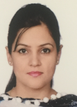
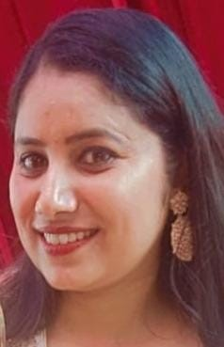
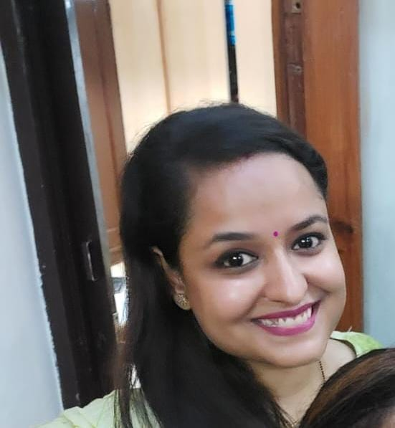
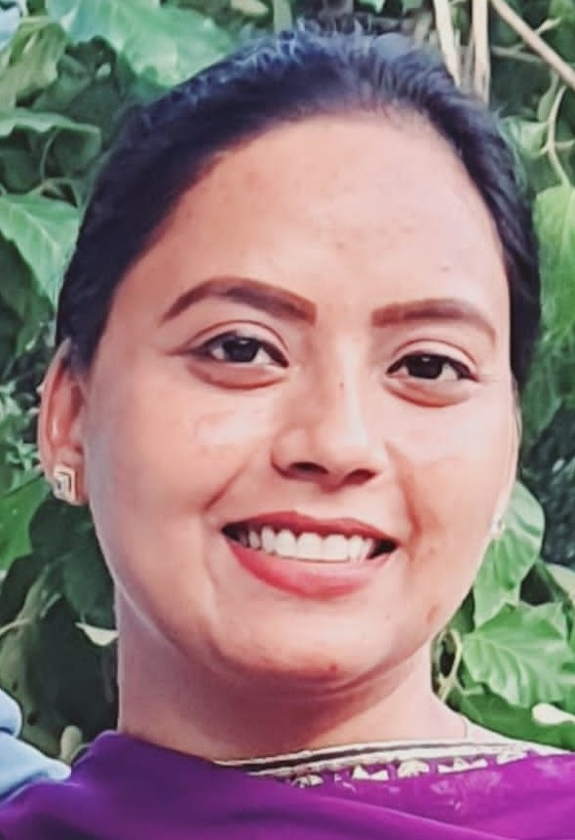
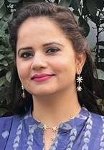
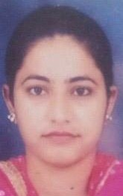
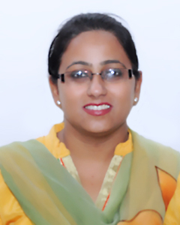
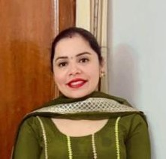
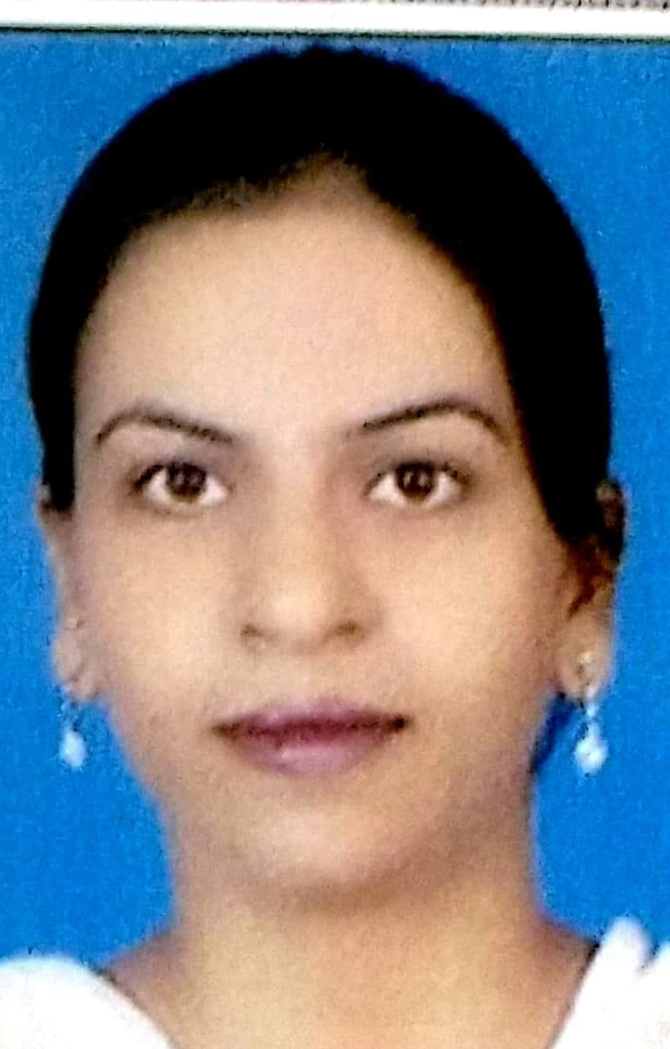
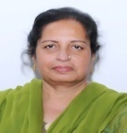
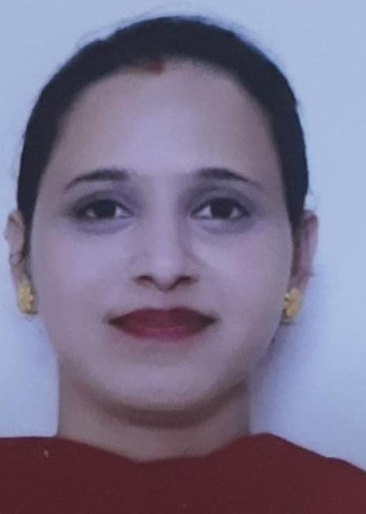
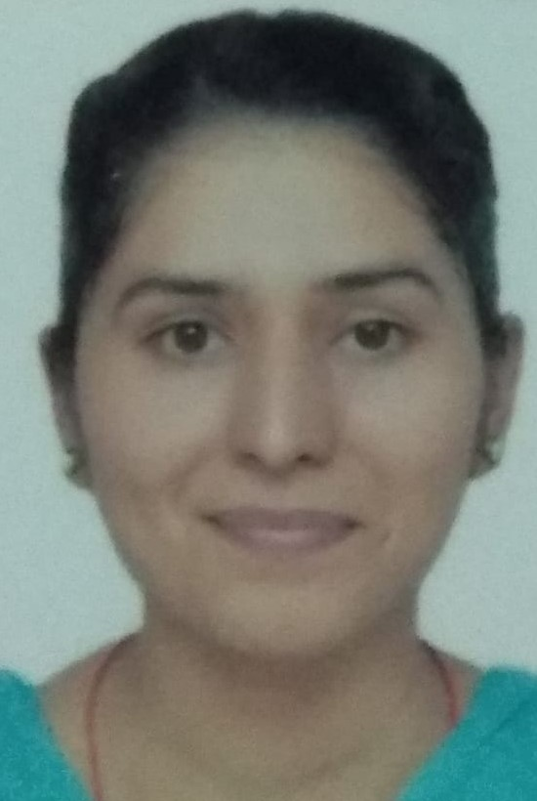
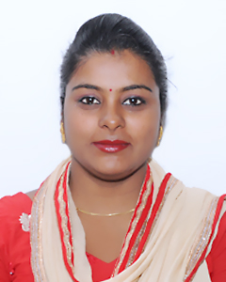
Ms. Raminder Kaur | Assistant Professor | M.A.(Eng), M.Ed(Edu), UGC NET (Edu), | 16.07.2018 to till date | 6 years
Mrs. Anju Sharma | Assistant Professor | M.A.(Eco), M.Ed(Edu), UGC NET (Edu) | 9.07.2018 to till date | 7 years
Mrs Jyotsna | Assistant Professor | M.Sc.(Che), M.Ed(Edu), UGC NET (Edu) | 01. 10.2019 to 12.8.2022 | 4 years
Mrs. Amanpreet Kaur | Assistant Professor | M.A.(Eco), M.Ed(Edu), UGC NET (Edu), | 15.11.2021 to till date | 5 years
Ms. Manjogita | Assistant Professor | M.A (Eng, Pbi, His), M.Ed(Edu), UGC NET (Edu), | 01.03.2021 to till date | 3 years
Mrs. Sukhmandeep Kaur | Assistant Professor | M.Sc.(Physics), M.Ed, JRF/ NET (Edu) | 15. 11.2021 to till date | 4 years
Mrs. Navdeep Kaur | Assistant Professor | M.Sc.(Maths), M.Ed(Edu), UGC NET (Edu) | 15. 11.2021 to till date | 5 months
Dr. Arvinder Kaur | Assistant Professor | M.A.(Music), M.Ed (Music), UGC NET (Edu),Ph.D.(Edu) | 14.06.2018 to till date | 13 years
Mrs. Ramandeep Kaur | Assistant Professor | M.Sc.(Physics), M.Ed, UGC/ NET (Edu) | 22.08.22 to till date | 3 years
Dr. Ritu Arora | Assistant Professor | M.Sc.(Zoology), M.A. (Psy),M.Ed , NET(Edu), Ph.D.(Edu) | 22.08.22 to till date | 17 years
Dr. Indu Sudhir | Assistant Professor | M.A.(Fine Arts, Hindi), M.Ed(Edu), UGC NET (Edu),Ph.D.(Edu) | 14.10.1994 to till date | 27 years
Mrs. Kirandeep Kaur | Assistant Professor | M.Sc.(Maths), B.Ed.M.Ed., UGC NET (Edu) | 22.08.22 to till date | 01 Year
Ms. Manpreet Kaur | Assistant Professor | MA (Pbi), B.Ed.M.Ed | 22.08.22 to 31-05-2023 | 1 Year
Mrs. Sandeep Kaur | Assistant Professor | B.P. Ed, M.P.Ed | 23.10.2019 to till date | 7 years

